Slide 1

At [your library]
Listening Workshop - [date]

Slide 2


Let’s take a collective breath together
TakeOneSmallStep.org

Slide 3

Let’s take a collective breath together
TakeOneSmallStep.org

Slide 4
AGENDA
Welcome (10 mins)
Listening Exercise (30 mins)
Group Reflection (15 mins)
Survey and Closing (5 mins)
TakeOneSmallStep.org
Notes:
‹#›

Slide 5


Introductions
Please share:
Your name
Where’s home?
Why did you want to attend this workshop?
TakeOneSmallStep.org
Notes:
Let’s have our circle be in alphabetical order today!

Slide 6
Listening & Affirmation
TakeOneSmallStep.org

Slide 7

Active Listening
Listening to understand, not to respond.
Put your full attention on the words and body language of the speaker.
Suspending judgement to put yourself in the speaker’s shoes.
TakeOneSmallStep.org

Slide 8
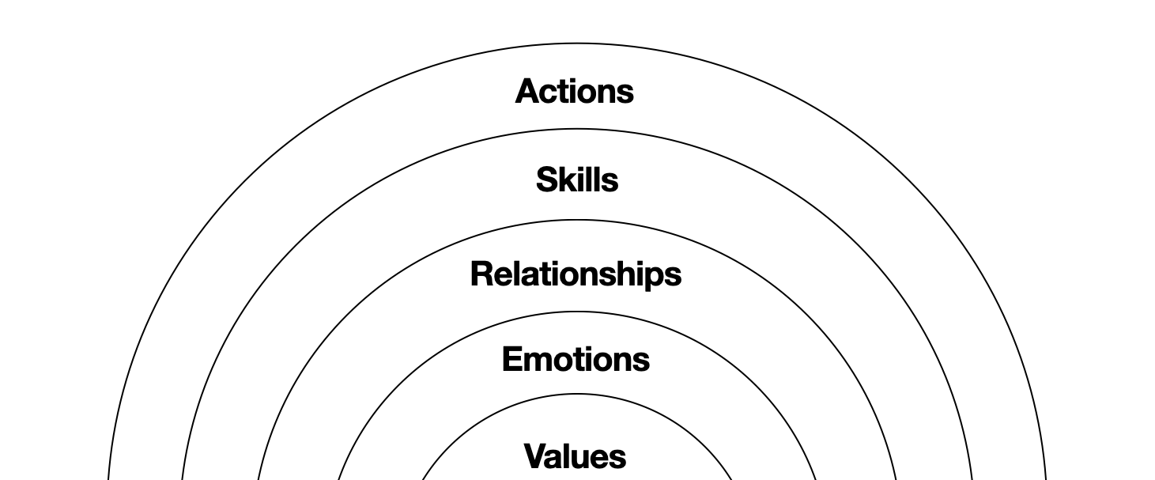
Layers of Meaning
TakeOneSmallStep.org

Slide 9
Affirmation
Demonstrates that you heard what the speaker shared.
Shows that you value connecting with the other person.
Does not require agreement.
Can be an exact repeating back or highlight emotions, values, etc.
“It sounds like…”
“I heard…”
“I really
appreciated…”
TakeOneSmallStep.org

Slide 10
Instructions
Step 1: Listen
Step 2: Affirm
Listen to a 2-minute OSS clip.
Full attention on what the speaker is saying.
Try to put yourself in
the speaker’s shoes.
Write your summary
in the chat.
Respond directly to
the person in the clip.
Read others’ summaries.
TakeOneSmallStep.org

Slide 11
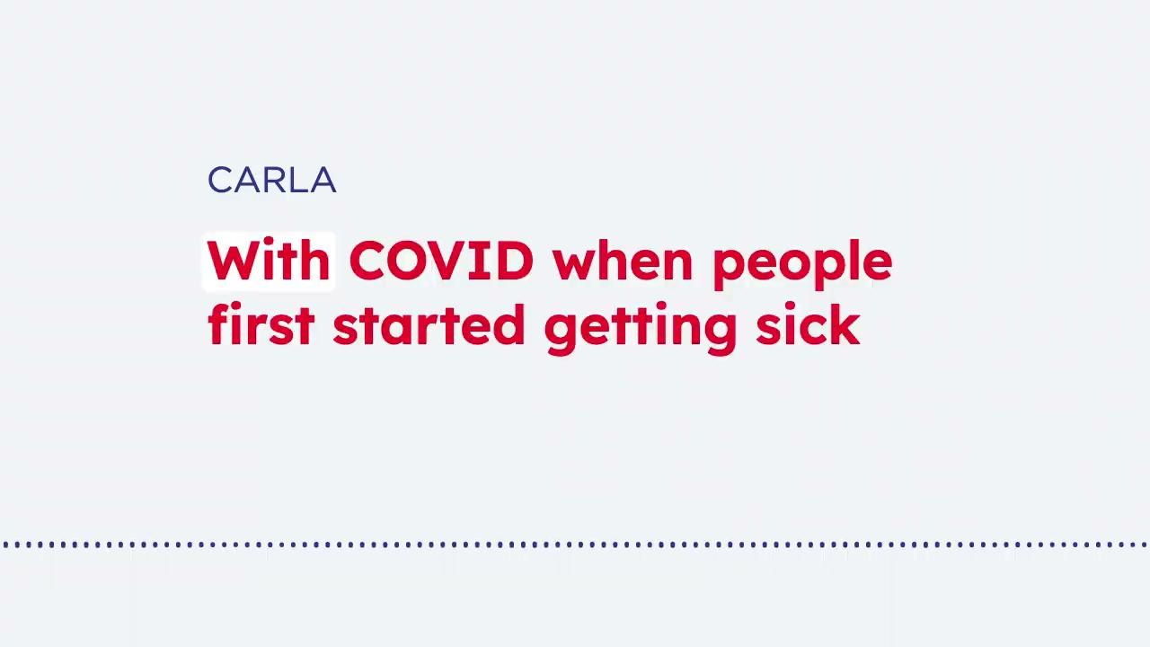
TakeOneSmallStep.org

Slide 12
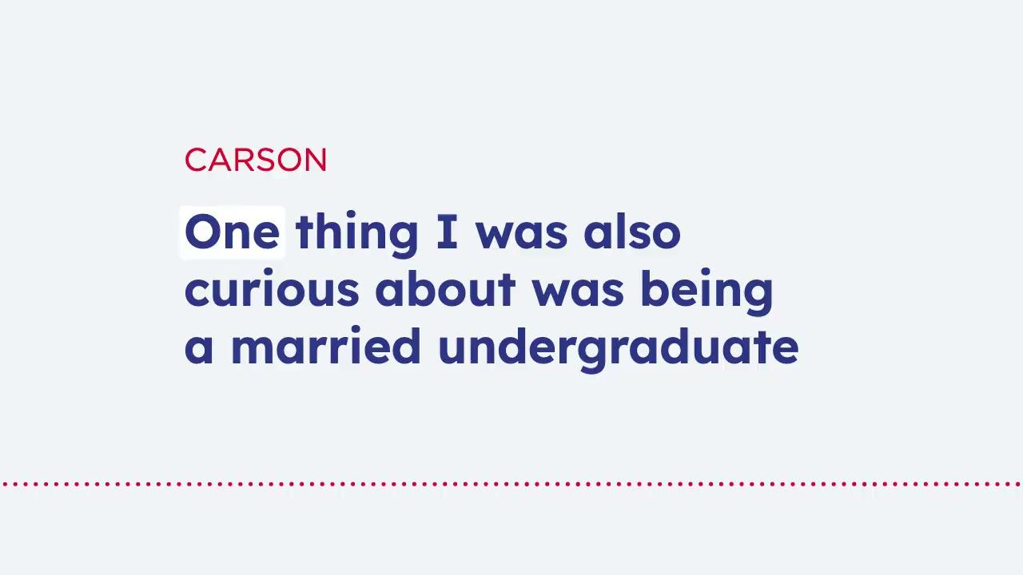
TakeOneSmallStep.org

Slide 13
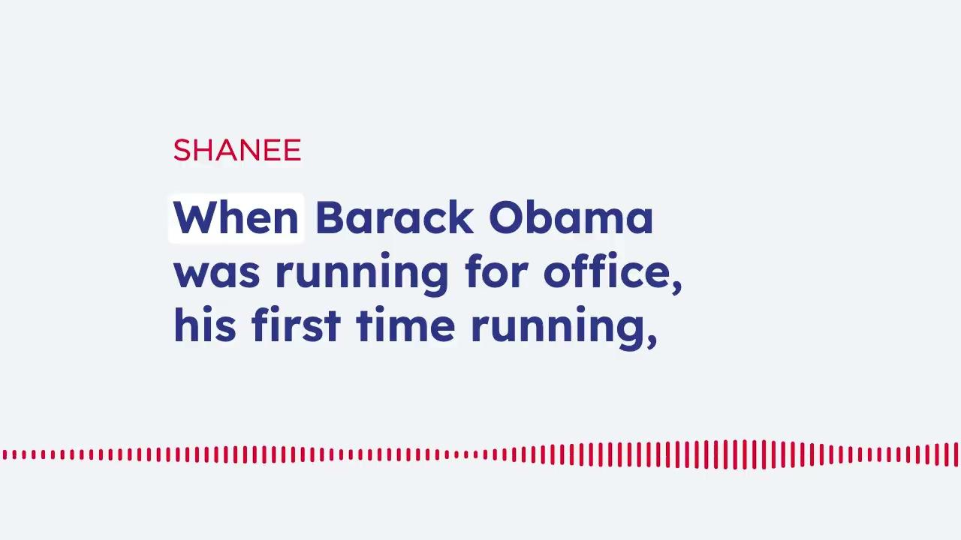
TakeOneSmallStep.org

Slide 14

TakeOneSmallStep.org

Slide 15
Quick Tips
Use with people you trust have good intentions.
Make it your own.
Be authentic and genuine.
Even just thinking about it builds the muscle.
TakeOneSmallStep.org

Slide 16

Reflect
TakeOneSmallStep.org

Slide 17
SHARE IN A GO-AROUND
What’s one thing
you’re taking away?
TakeOneSmallStep.org

Slide 18

One Small Survey
TakeOneSmallStep.org

Slide 19


